Slide 1

Chapter 10
Error Detection and Correction
School of Computer Science and Engineering
Pusan National University
Jeong Goo Kim

Slide 2
Ch. 10 Outline
    Outline
10.1 Introduction
10.2 Block Coding
10.3 Cyclic Codes
10.4 Checksum
10.5 Forward Error Correction

Slide 3
    Ch. 10 Objective
    Objective
The first section introduces types of errors, the concept of redundancy, and distinguishes between error detection and correction.
The second section discusses block coding. It shows how error can be detected using block coding and also introduces the concept of Hamming distance.
The third section discusses cyclic codes. It discusses a subset of cyclic code, CRC, that is very common in the data-link layer. The section shows how CRC can be easily implemented in hardware and represented by polynomials.

Slide 4
    Ch. 10 Objective
    Objective (continued)
The fourth section discusses checksums. It shows how a checksum is calculated for a set of data words. It also gives some other approaches to traditional checksum.
The fifth section discusses forward error correction. It shows how Hamming distance can also be used for this purpose. The section also describes cheaper methods to achieve the same goal, such as XORing of packets, interleaving chunks, or compounding high and low resolutions packets.

Slide 5
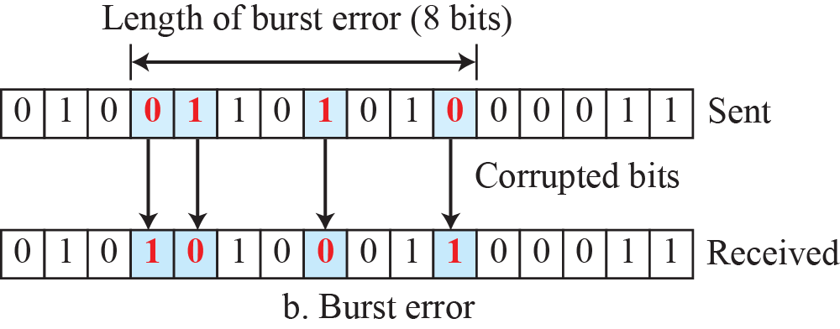
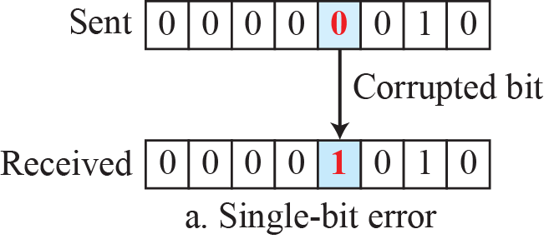
    10.1 Introduction
    10.1 Introduction
    10.1.1 Types of error
Fig. 10.1 Single-bit and burst error

Slide 6
    10.1 Introduction
    10.1.2 Redundancy
is some extra bits inserted in original data to be able to detect or correct errors.
    10.1.3 Detection vs. Correction
In error detection, we are only looking to see if any error has occurred.
In error correction, we need to know the exact number of bits that are corrupted and, more importantly, their location in the message
    10.1.4 Coding
is the method to insert redundancy into original data.
  Block coding
  Convolutional coding

Slide 7
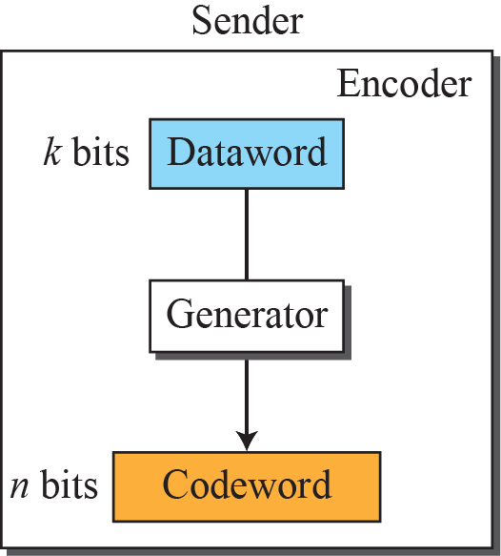
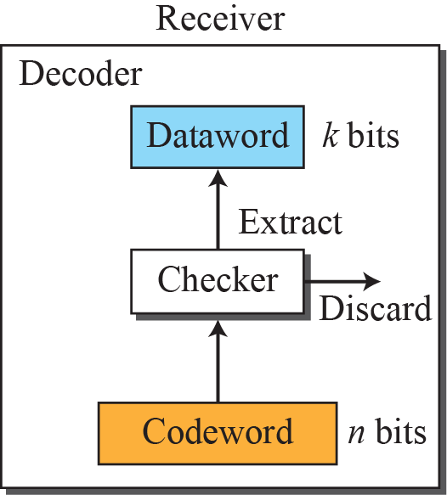

    10.2 Block Coding
    10.2 Block Coding
n-bit Codeword = k-bit dataword + r-bit redundant
    10.2.1 Error Detection
If the following two conditions are met, the receiver can detect a change in the original codeword.
  The receiver has (or can find) a list of valid codewords.
  The original codeword has changed to an invalid one.
Fig. 10.2 Process of error detection in block coding

Slide 8
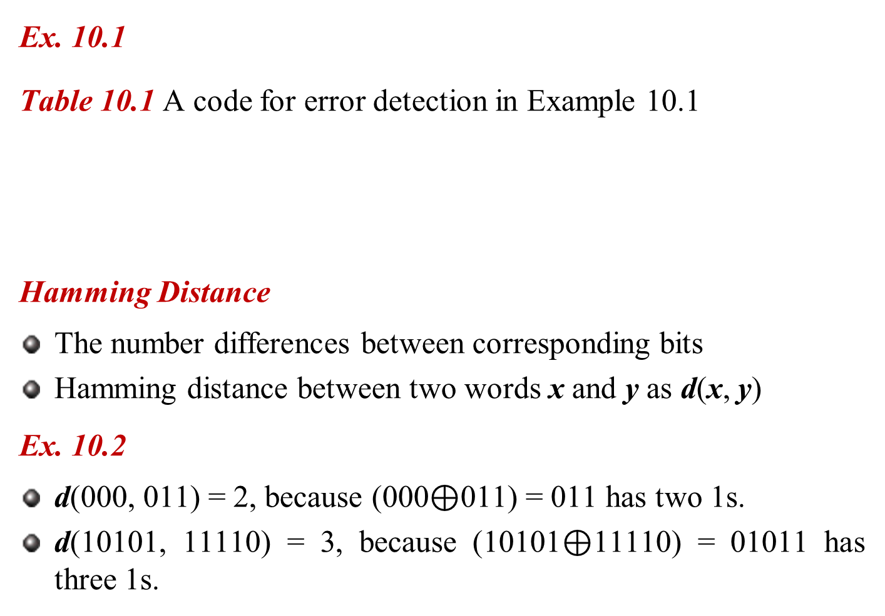
    10.2 Block Coding
    Ex. 10.1
    Table 10.1 A code for error detection in Example 10.1
    Hamming Distance
The number differences between corresponding bits
Hamming distance between two words x and y as d(x, y)
    Ex. 10.2
d(000, 011) = 2, because (000$⊕$011) = 011 has two 1s.
d(10101, 11110) = 3, because (10101$⊕$11110) = 01011 has three 1s.

Slide 9
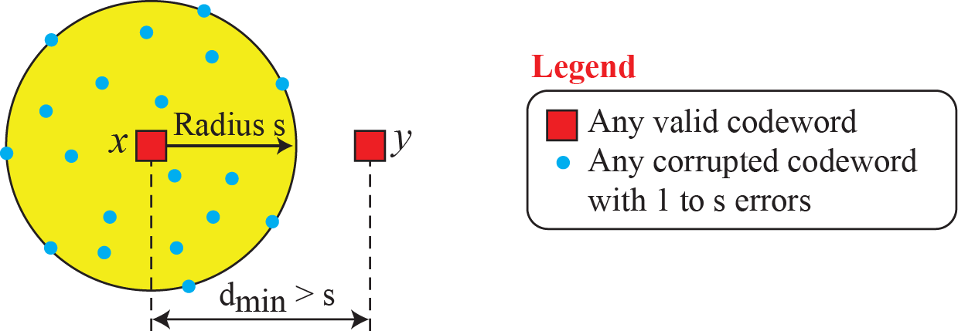
    10.2 Block Coding
    Minimum Hamming distance
is the smallest Hamming distance between all possible pairs of codewords.
    Minimum Hamming distance for Error detection
To guarantee the detection of up to s errors
d_{min} = s + 1
Fig. 10.3 Geometric concept explaining d_{min} in error detection

Slide 10
    10.2 Block Coding
    Linear Block Codes
Almost all block codes used today is linear.
A binary code is linear if and only if the sum of any two codewords is a codeword.
    Minimum Hamming distance of Linear Block Codes
is the number of 1s in the nonzero valid codeword with the smallest number of 1s.

Slide 11
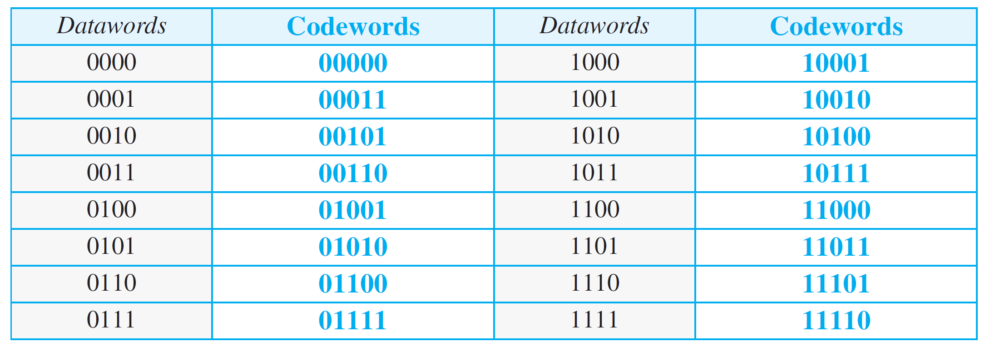
    10.2 Block Coding
    Parity Check Code
    Table 10.2 Simple parity-check code C(5,4)

Slide 12
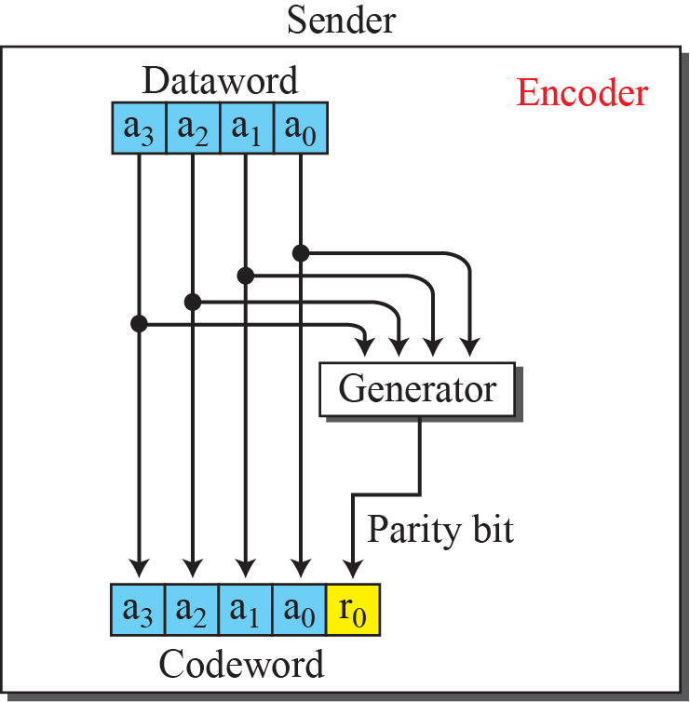
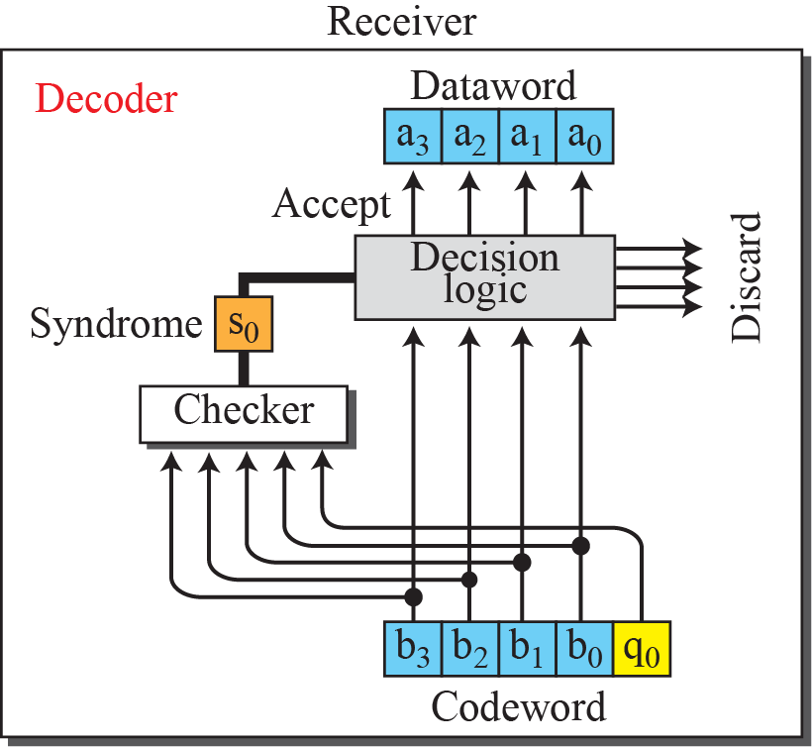
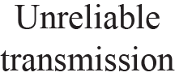

    10.2 Block Coding
Redundancy $r_{0}=a_{3}+a_{2}+$ $a_{1}+$ $a_{0}$ (modulo-2)
Syndrome $s_{0}=b_{3}+b_{2}+$ $b_{1}+$ $b_{0}+$ $q_{0}$ (modulo-2)
    Fig. 10.4 Encoder and decoder for simple parity-check code

Slide 13
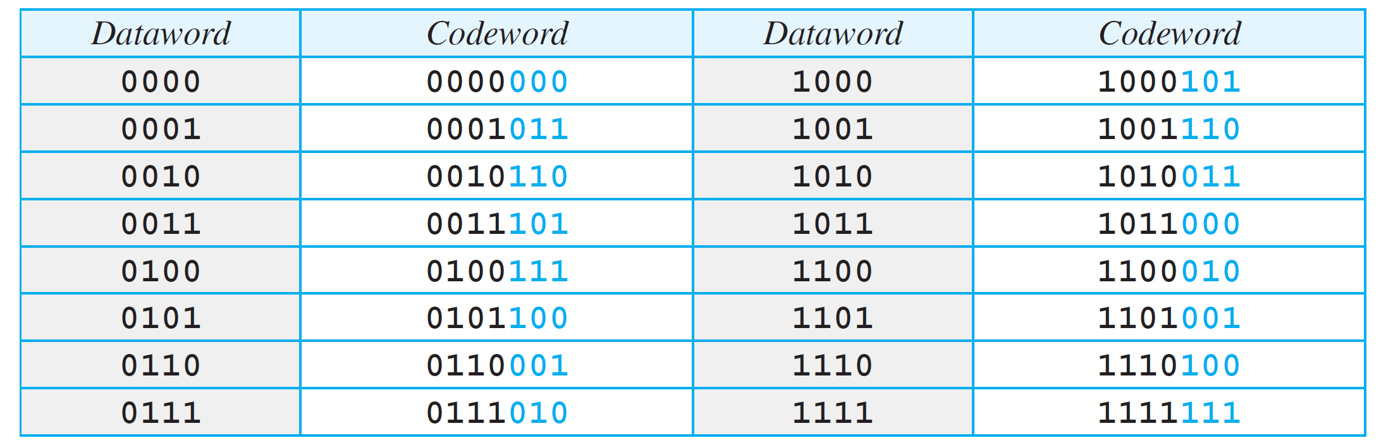
    10.3 Cyclic Codes
    10.3 Cyclic Codes
are special linear block codes with one extra property.
if a codeword is cyclically shifted (rotated), the result is another codeword.
10.3.1 Cyclic Redundancy Check (CRC)
is used in networks such as LANs and WANs.
Table 10.3 A CRC code with C(7,4)

Slide 14
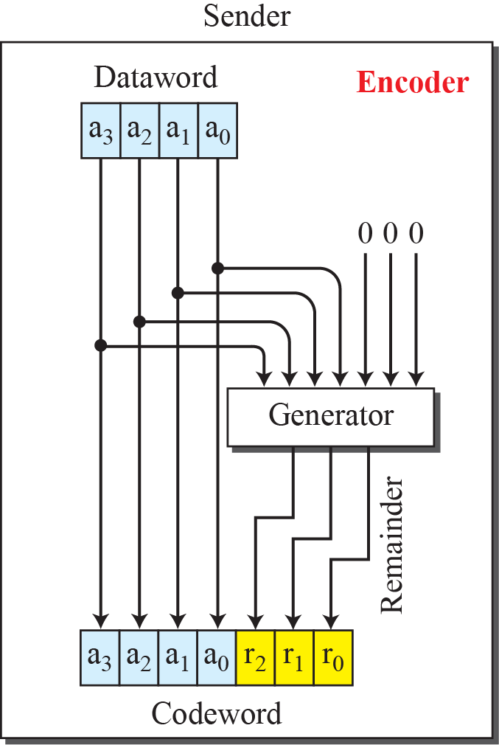
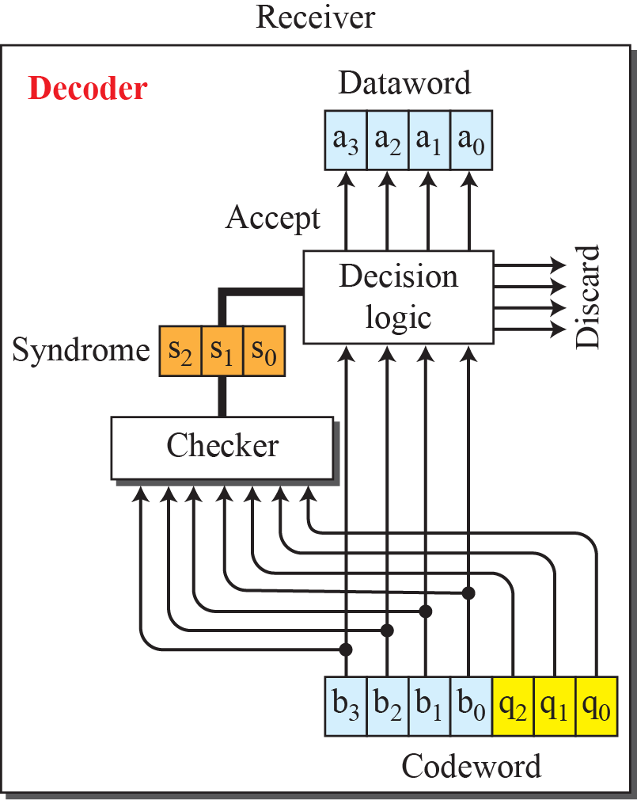
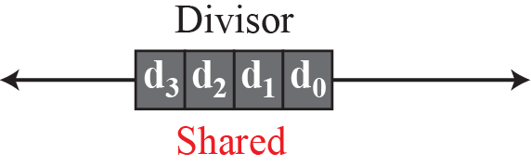
    10.3 Cyclic Codes
    Fig. 10.5 CRC encoder and decoder

Slide 15
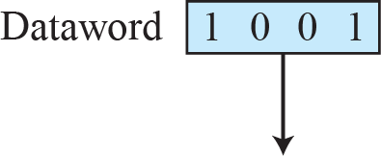
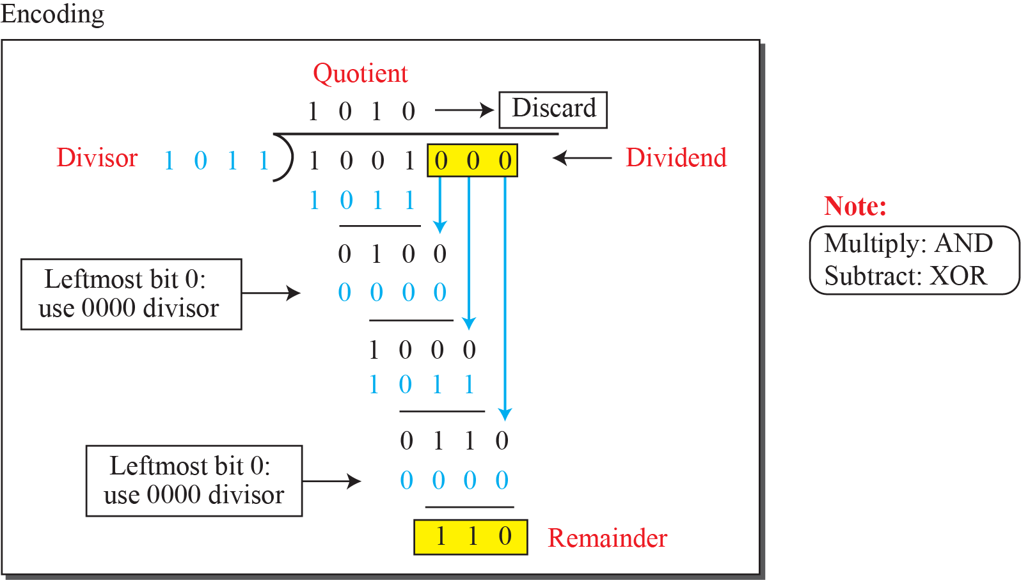
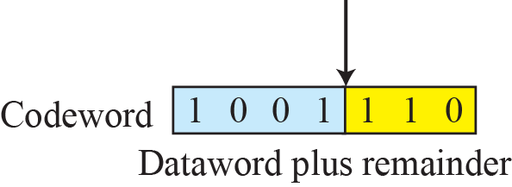
    10.3 Cyclic Codes
    Encoder
    Fig. 10.6 Division in CRC encoder

Slide 16
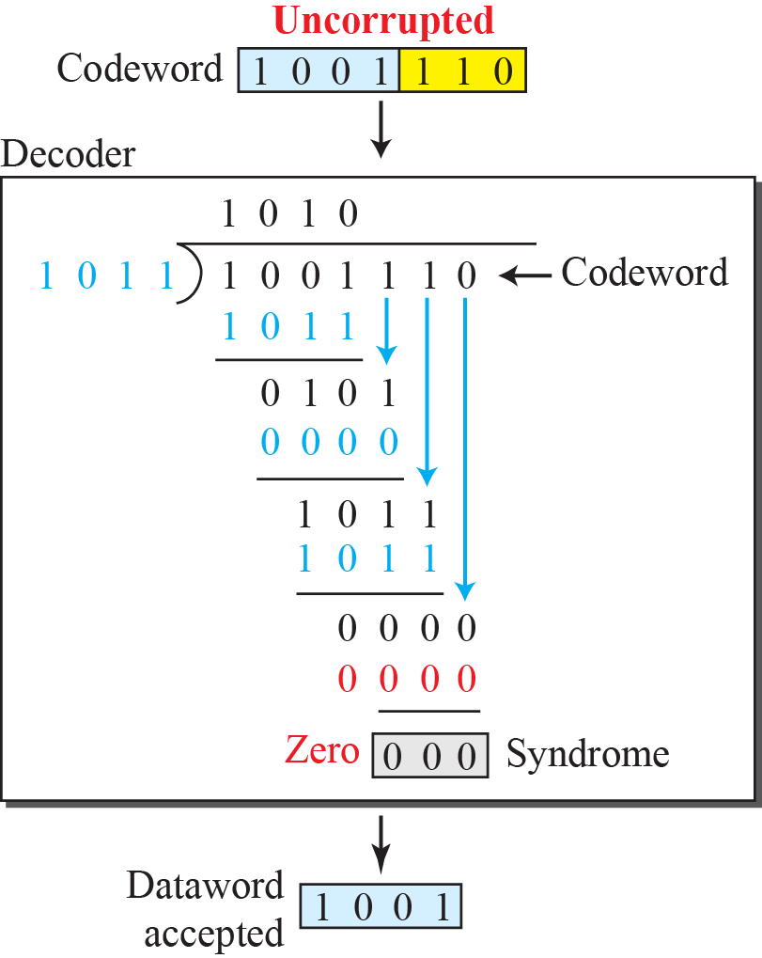
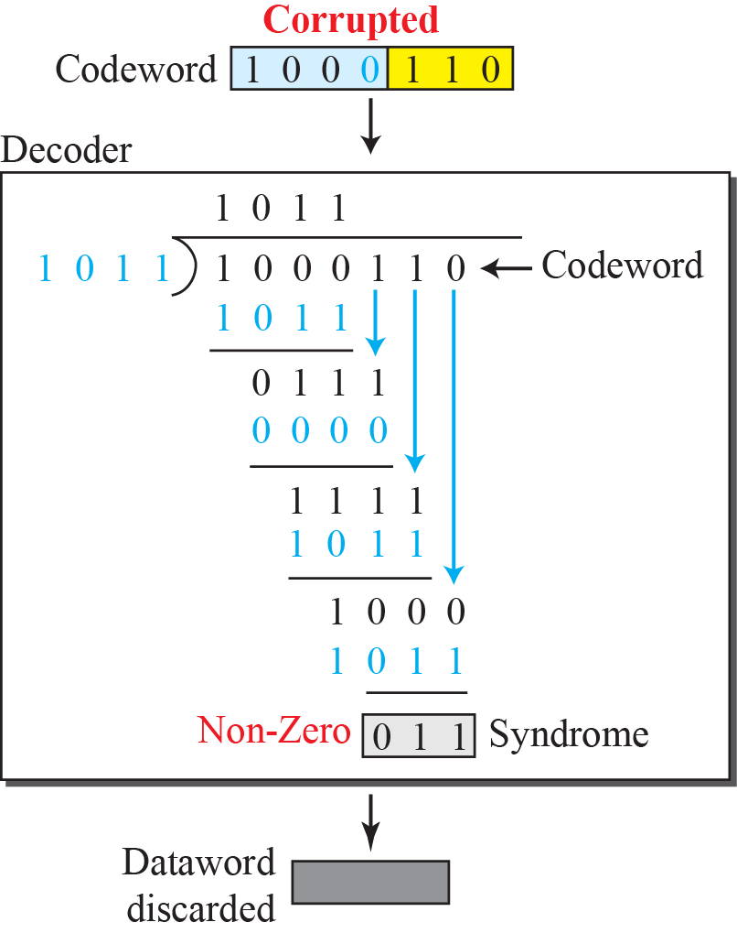
    10.3 Cyclic Codes
    Decoder
Fig. 10.7 Division in CRC decoder for two cases

Slide 17
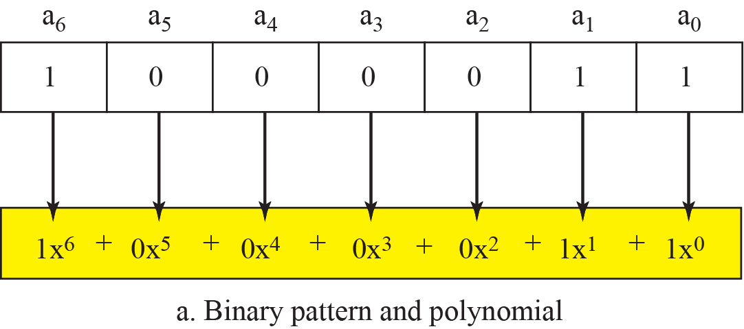
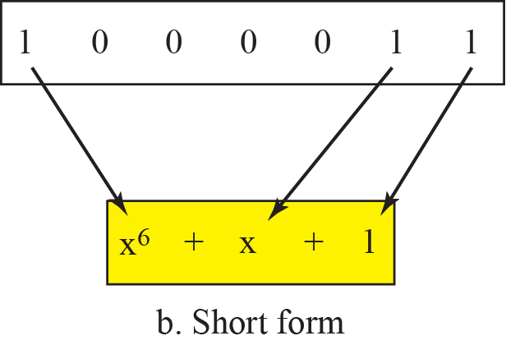
    10.3 Cyclic Codes
10.3.2 Polynomials
Fig. 10.8 A polynomial to represent a binary word

Slide 18
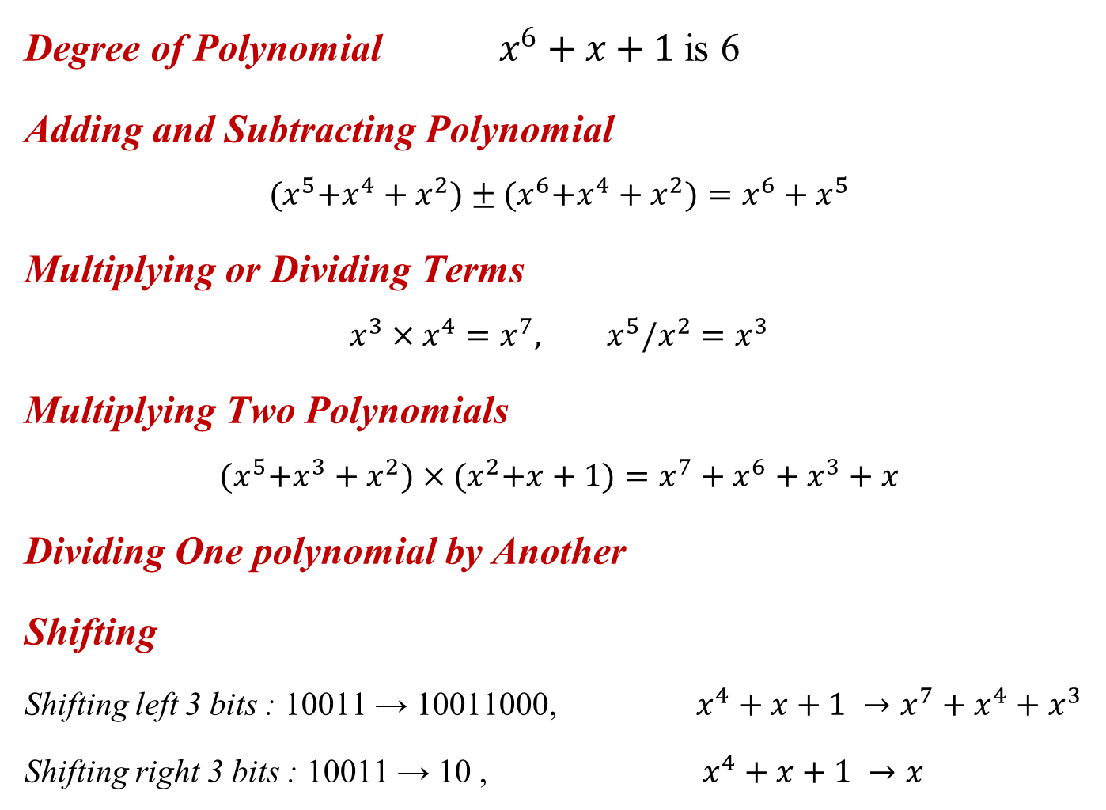
    10.3 Cyclic Codes
Degree of Polynomial $x^{6}+x+1$ is 6
Adding and Subtracting Polynomial
$${(x}^{5}+x^{4}+x^{2})±{(x}^{6}+x^{4}+x^{2})=x^{6}+x^{5}$$
Multiplying or Dividing Terms
$$x^{3}×x^{4}=x^{7}, { x}^{5}/x^{2}=x^{3}$$
Multiplying Two Polynomials
$${(x}^{5}+x^{3}+x^{2})×{(x}^{2}+x+1)=x^{7}+x^{6}+x^{3}+x$$
Dividing One polynomial by Another
Shifting
Shifting left 3 bits : 10011 → 10011000, $x^{4}+x+1 →x^{7}+x^{4}+x^{3}$
Shifting right 3 bits : 10011 → 10 , $x^{4}+x+1 →x$

Slide 19
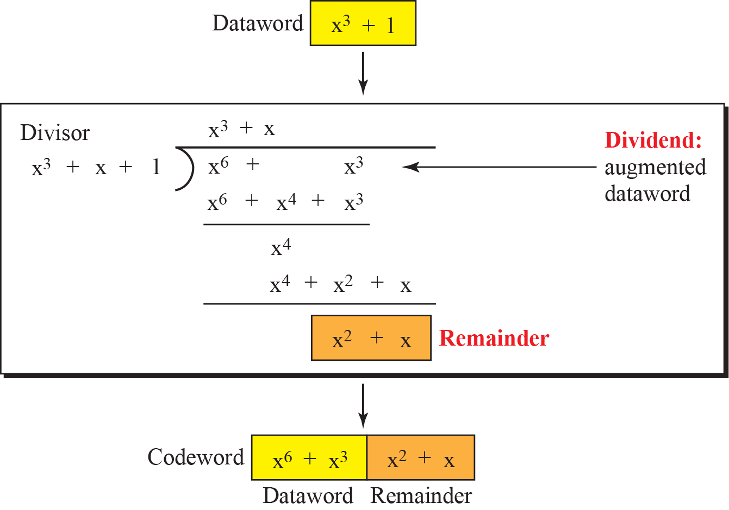
    10.3 Cyclic Codes
    10.3.3 Encoder Using Polynomials
Fig. 10.9 CRC division using polynomials

Slide 20
    10.3 Cyclic Codes
    10.3.4 Cyclic Code Analysis
Dataword: d(x)
Generator: g(x)
Codeword: c(x) = d(x) g(x)
Error vector: e(x)
Received vector: r(x) = g(x) + e(x)
Syndrome: s(x)=r(x)/g(x) = c(x)/g(x)+e(x)/g(x)=e(x)/g(x)
  If s(x)≠0, one or more bits is corrupted
  If s(x)=0, No bits is corrupted or some bits are corrupted but not detected
Single-bit Error
  If the g(x) has more than one term and the coefficient x⁰ is 1, all single-bit errors can be caught

Slide 21
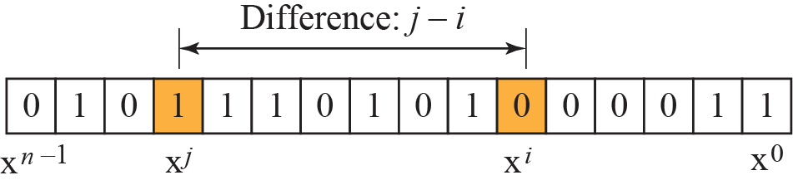
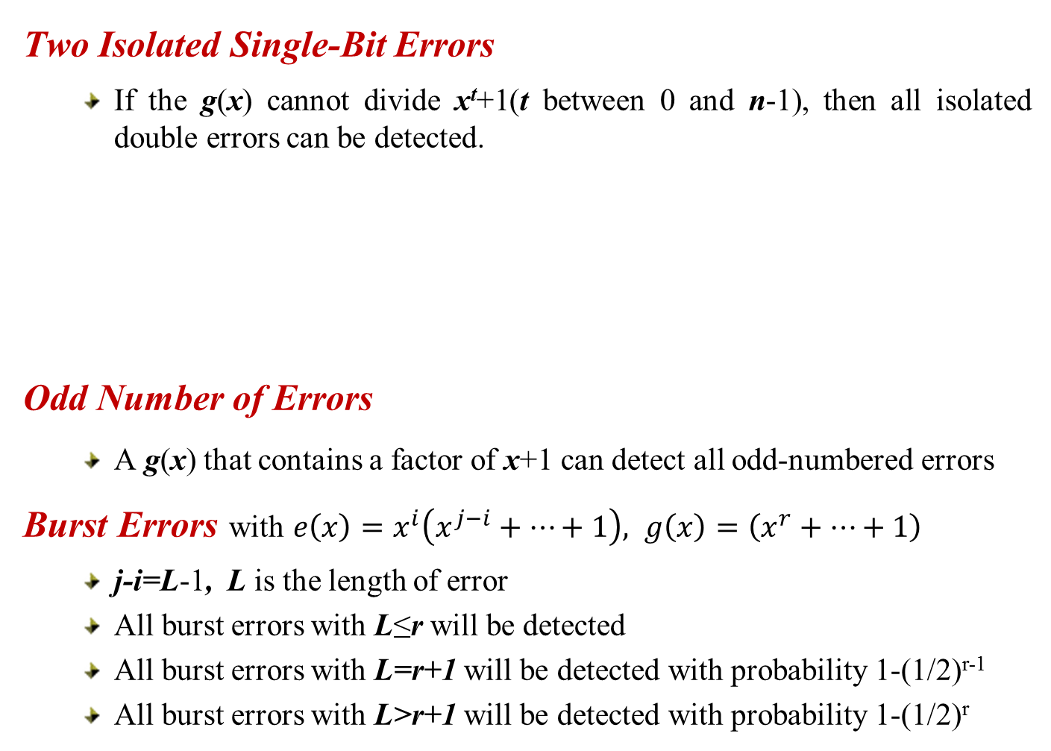
    10.3 Cyclic Codes
    Two Isolated Single-Bit Errors
  If the g(x) cannot divide x^{t}+1(t between 0 and n-1), then all isolated double errors can be detected.
    Odd Number of Errors
  A g(x) that contains a factor of x+1 can detect all odd-numbered errors
    Burst Errors with $e\left(x\right)=x^{i}\left(x^{j−i}+⋯+1\right), g\left(x\right)=\left(x^{r}+⋯+1\right)$
  j-i=L-1, L is the length of error
  All burst errors with L≤r will be detected
  All burst errors with L=r+1 will be detected with probability 1-(1/2)^{r-1}
  All burst errors with L>r+1 will be detected with probability 1-(1/2)^{r}

Slide 22
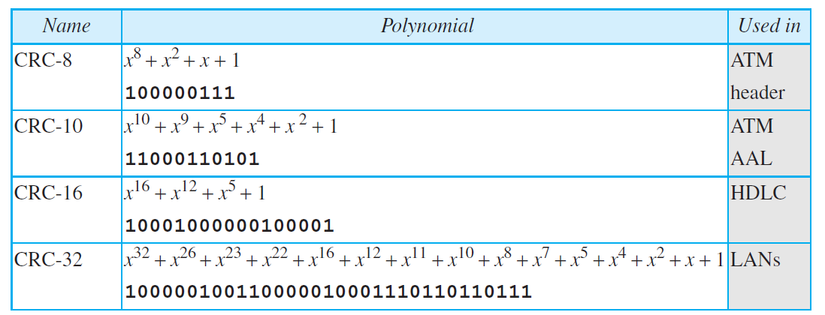
    10.3 Cyclic Codes
    A Good Polynomial Generator
  has at least two terms
  has “1”
  not divide x^{t}+1, for t between 2 and n-1
  has the factor x+1
Standard Polynomials

Slide 23
    10.3 Cyclic Codes
    10.3.5 Advantage of Cyclic Code
have a very good performance
can easily be implemented in hardware and software.
are especially fast when implemented in hardware.
    10.3.6 Other Cyclic Codes
based on Galois fields
ex.) Reed-Solomon code
    10.3.7 Hardware Implementation
encoder and decoder can easily and cheaply be implemented in hardware by using a handful of electronic devices.
a hardware implementation increases the rate of check bit and syndrome bit calculation.

Slide 24
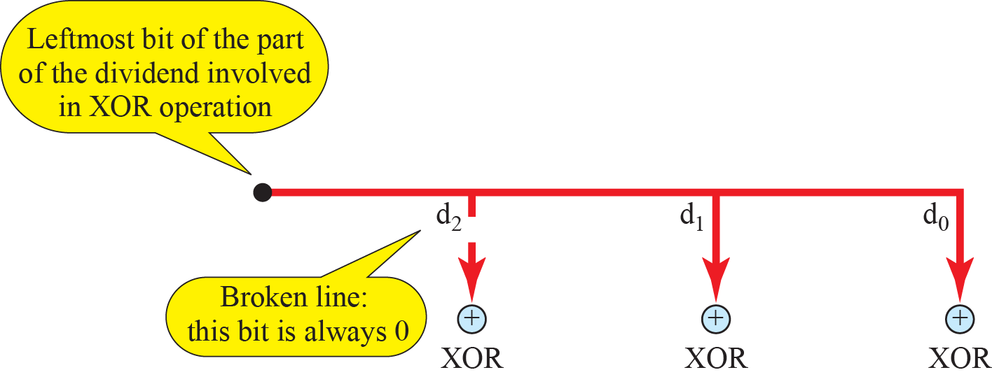
    10.3 Cyclic Codes
Hand-wired design of the divisor in CRC

Slide 25
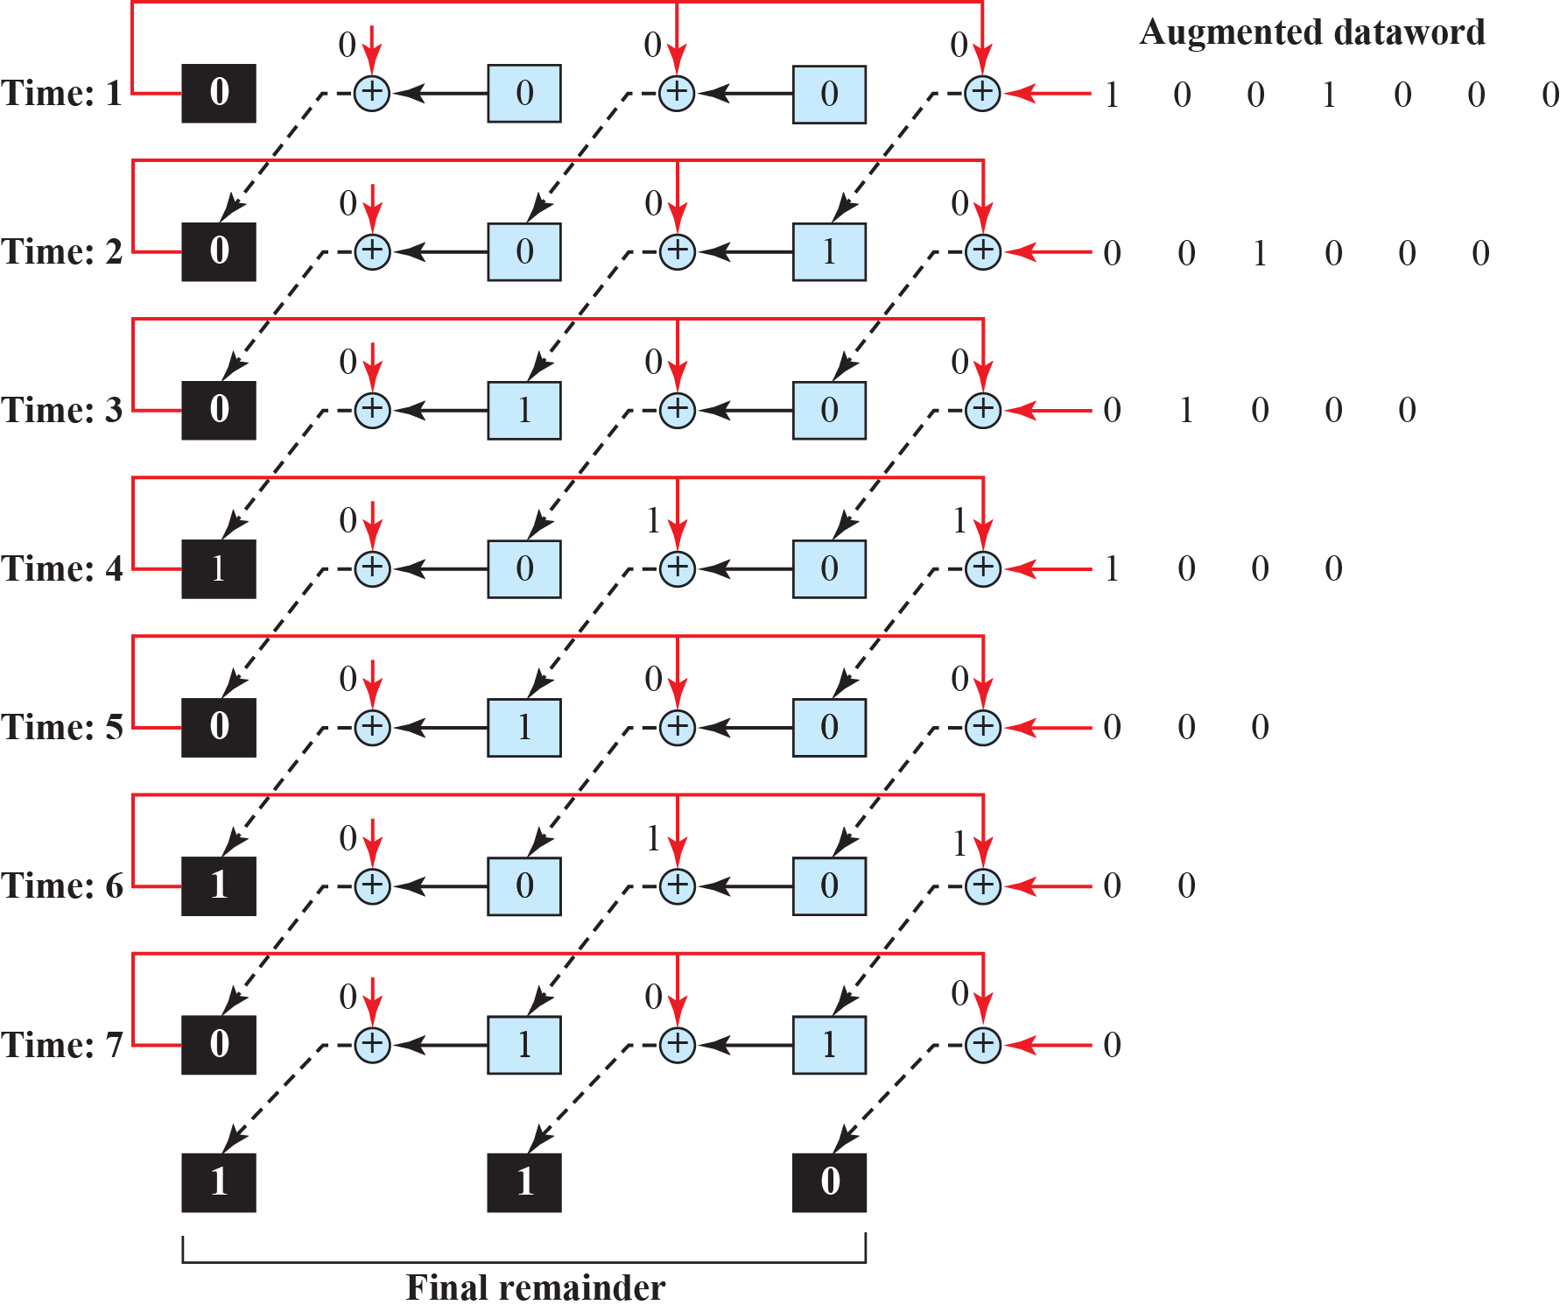
    10.3 Cyclic Codes
Simulation of division in CRC encoder

Slide 26
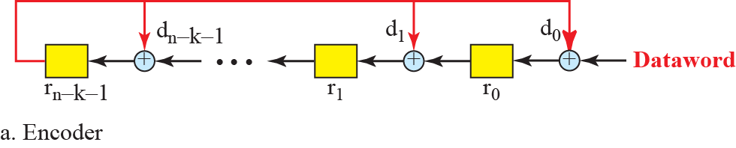
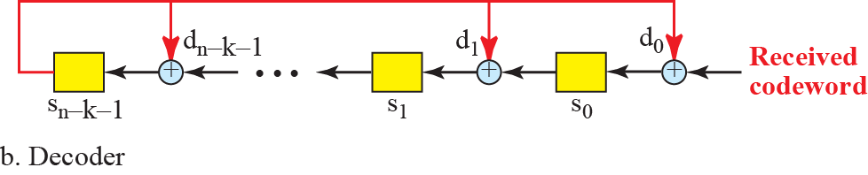
    10.3 Cyclic Codes
CRC encoding design using shift register
General design of encoder and decoder of CRC

Slide 27

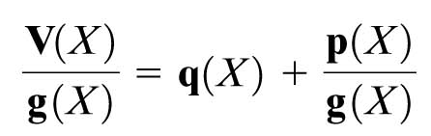
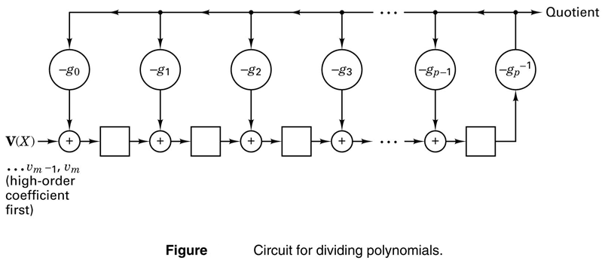
    10.3 Cyclic Codes
Circuit Implementation for Cycle Codes
Dividing Polynomials

Slide 28
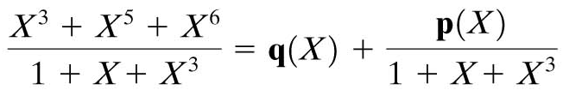
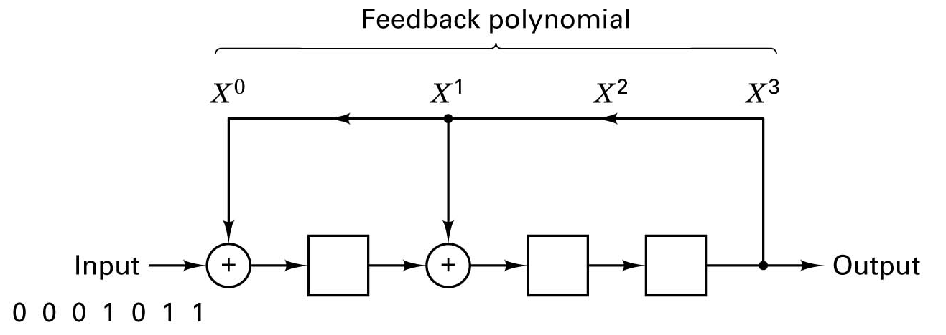
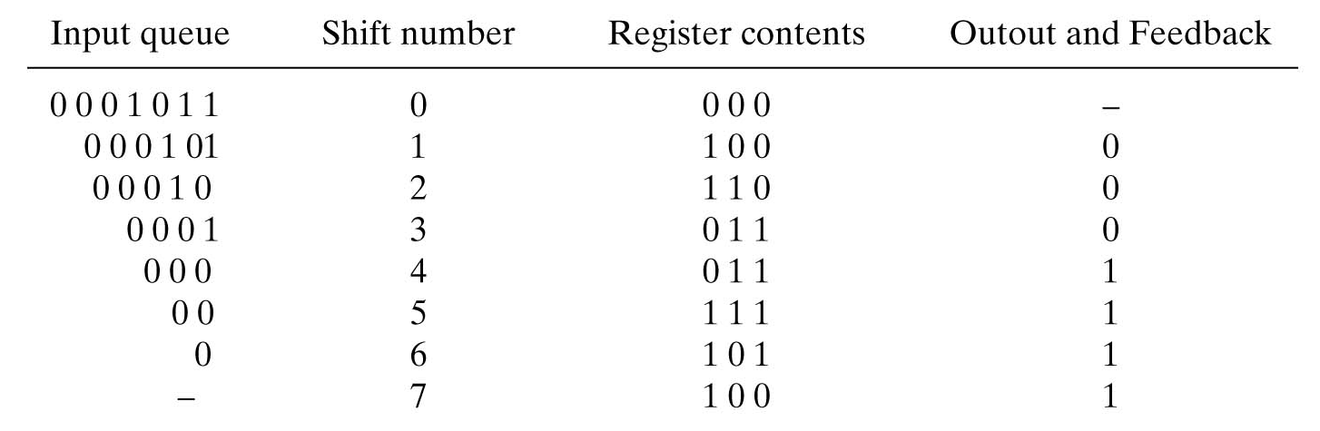
    10.3 Cyclic Codes
Example

Slide 29
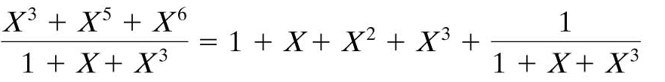
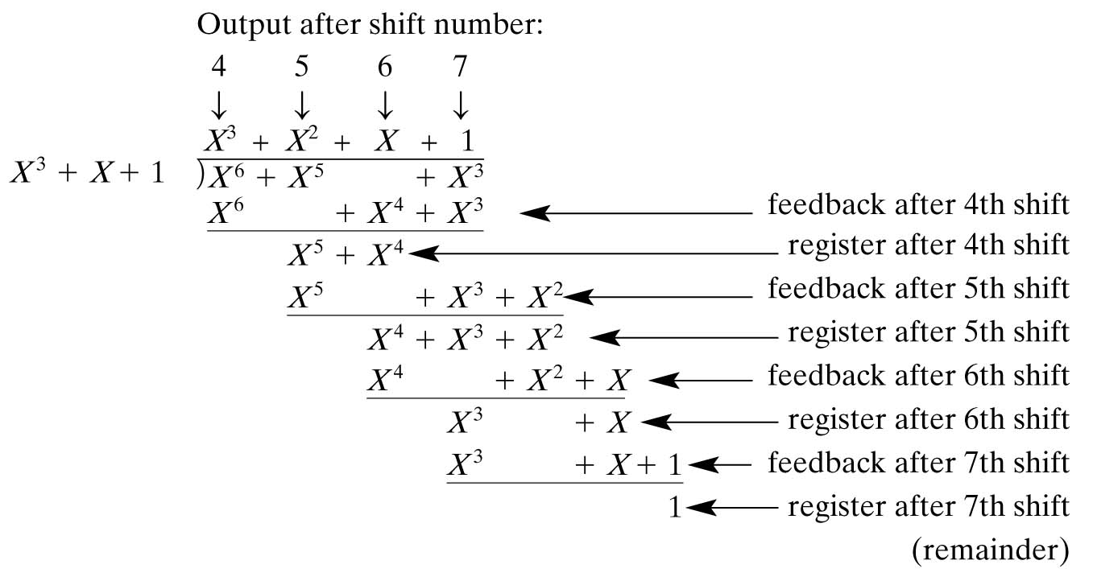
    10.3 Cyclic Codes
Example (continue)
  The quotient coefficients are serially presented at the output {1111}
  The registers contain the remainder coefficients {100}

Slide 30
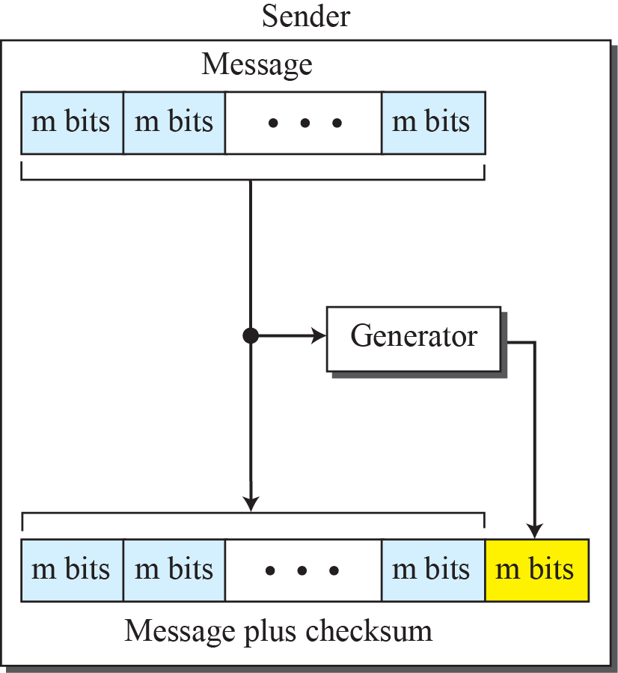
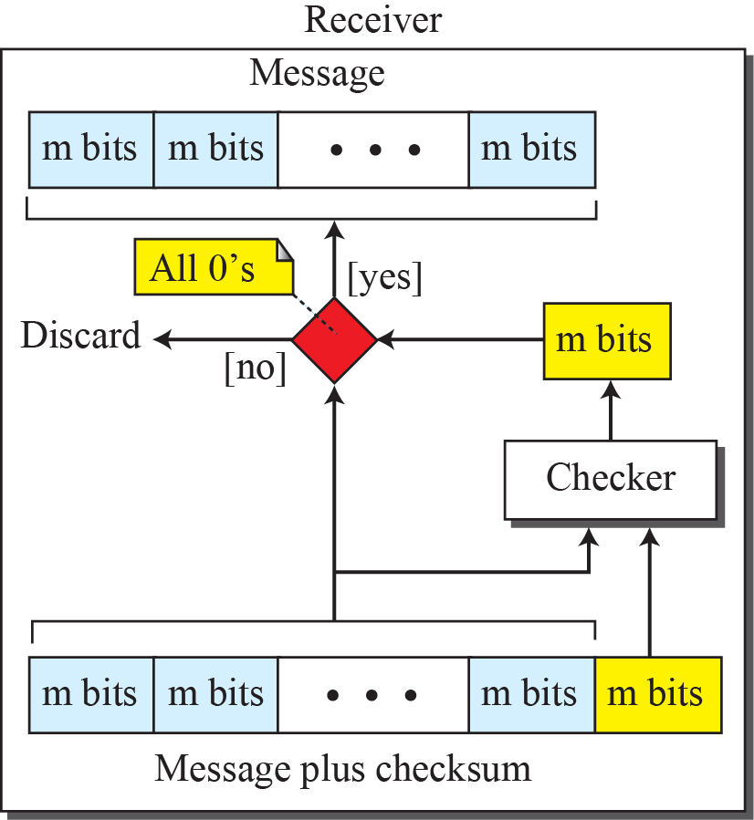
    10.4 Checksum
    10.4 Checksum
is an error-detecting technique that can be applied to a message of any length.
is mostly used at the network and transport layer rather than the data-link

Slide 31
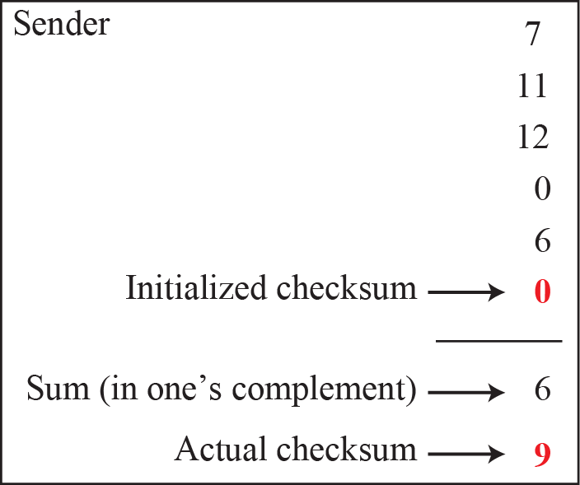
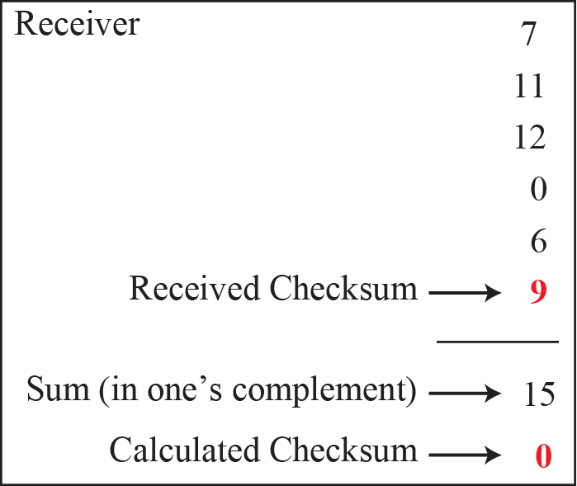
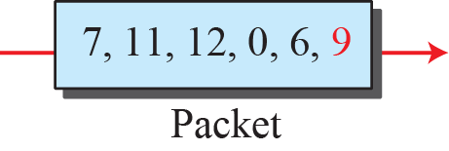
    10.4 Checksum
    10.4 .1 Concept
Ex. 10.11
Ex. 10.12
Ex. 10.13

Slide 32
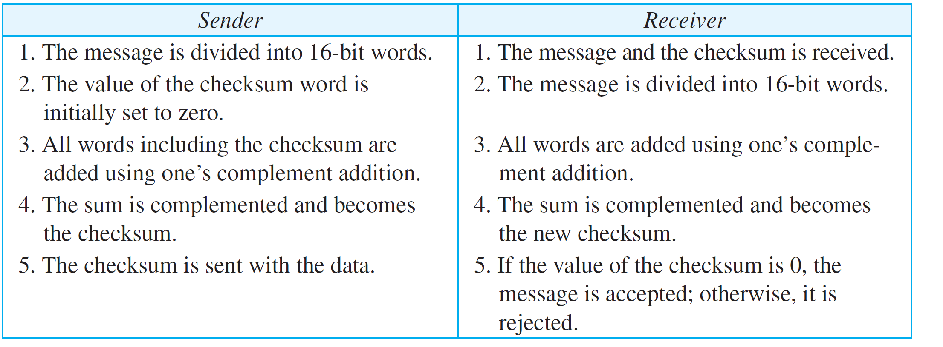
    10.4 Checksum
    Procedure to calculate the traditional checksum

Slide 33
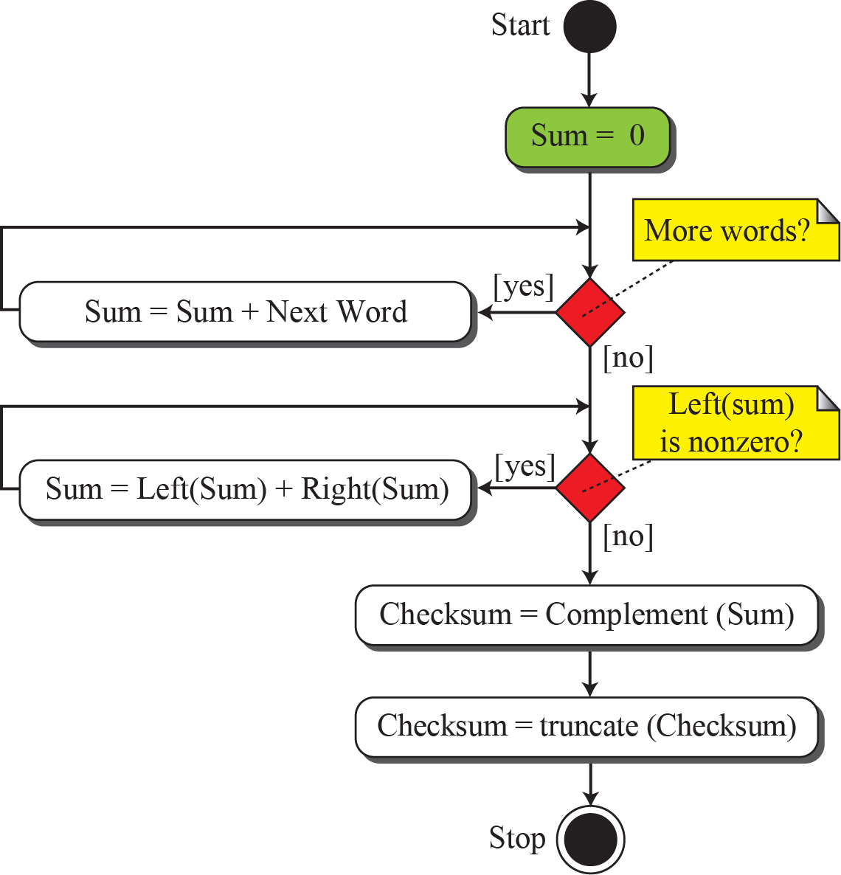
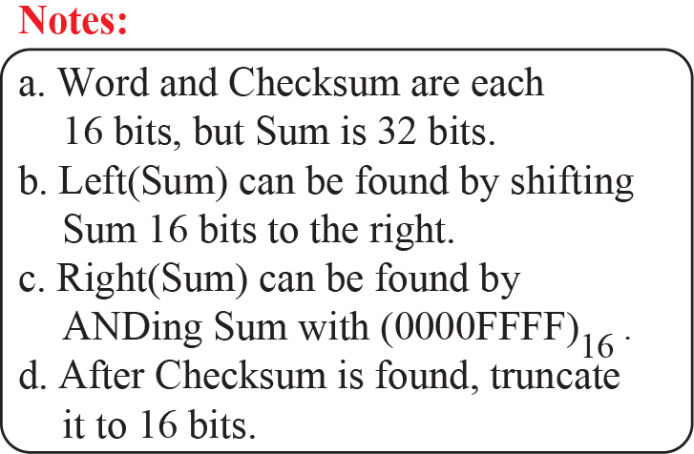
    10.4 Checksum
    Algorithm to calculate a traditional checksum

Slide 34
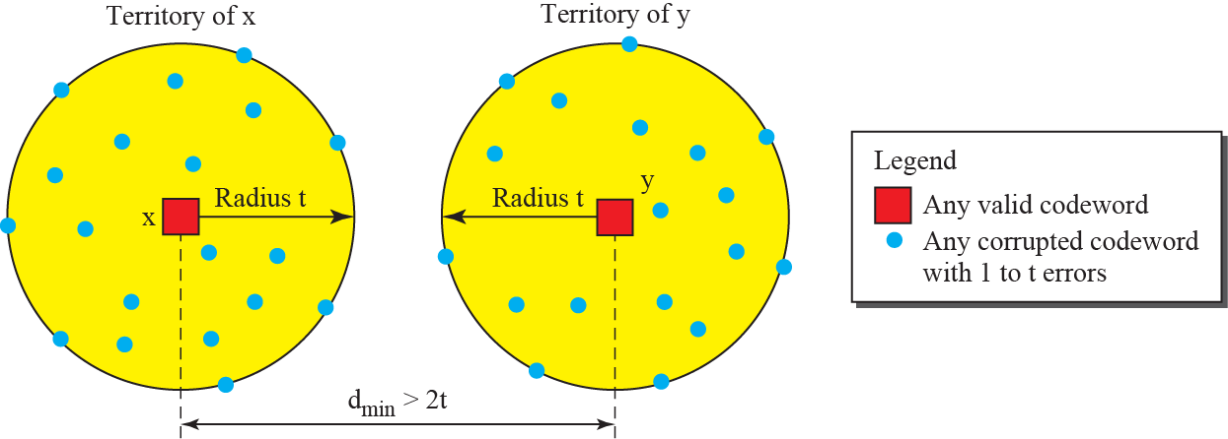
    10.5 Forward Error Correction
    10.5 Forward Error Correction
can correct the error or reproduce the packet immediately.
10.5.1 Using Hamming Distance
to correct t errors, d_{min} = 2t + 1

Slide 35
    Homework
Homework
Implement CRC encoder and decoder for given length of data with CRC-16 and any program language
Read textbook pp. 293-320
Next Lecture
Chapter 11. Data Link Control (DLC)

